Slide 1
C# LINQ
By Gintaras Armonaitis

Slide 2
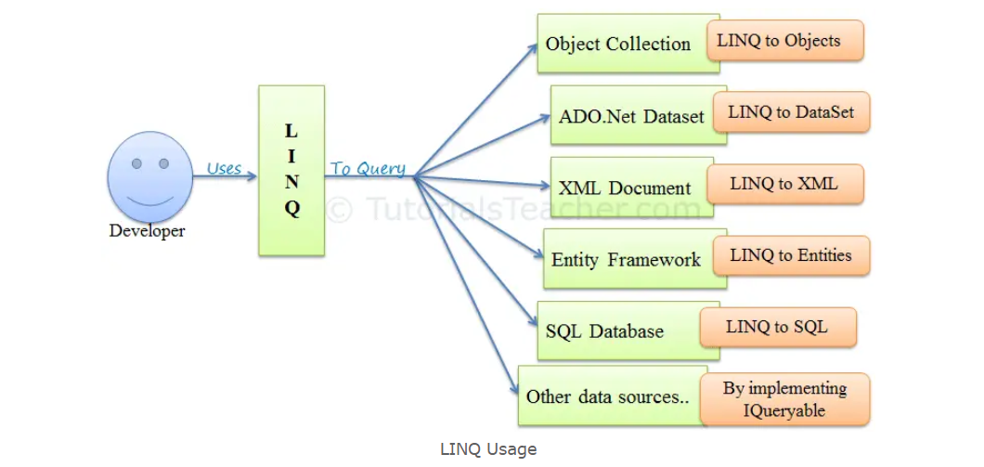
What is LINQ?
Language-Integrated Query (LINQ) is a uniform query language, introduced with .NET 3.5 that we can use to retrieve data from different data sources. These data sources include the collection of objects, relational databases, ADO.NET datasets, XML files, etc. Simplifies SQL queries

Slide 3
Steps of LINQ operations
Obtain the data source
Create the query
Execute the query

Slide 4
Obtain the Data Source
A valid LINQ data source must support the IEnumerable<T> interface or an interface that inherits from it.
The studentIds is an array that supports the IEnumerable<T> interface.

Slide 5
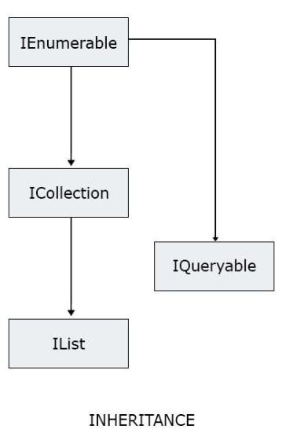
IEnumerable has the most restrictions

Slide 6

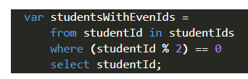
Create the Query
A query specifies what information we want to retrieve from the data source.
To create a query, we have to import LINQ into our code:

Slide 7
Execute the Query
There are two ways to execute a LINQ query:
Deferred Execution
Immediate Execution
foreach
Count, Average, Min, Max, etc. First, Last, ToArray, ToList

Slide 8
Pros and cons of Using LINQ
Pros:
Improves code readability
Provides compile-time object type-checking
Provides IntelliSense support for generic collection
LINQ queries can be reused
Provides in-built methods to write less code and expedite development
Provides common query syntax for various data sources

Slide 9
Cons:
Difficult to write complex queries as SQL
Performance degradation if queries are not written accurately
Require to recompile, and redeploy every time a change is made to the query
Doesn’t take full advantage of SQL features such as cached execution plan for stored procedure

Slide 10
Example project
https://github.com/ginarm1/LinqExamples/

